Slide 1

Glendale Quiet Zone
Planning Commission Update
01.05.17

Slide 2
Preliminary Review
Quiet Zone Improvements
Pedestrian Crossing
Albion Crossing
North Greenville Intersection

Slide 3
Pedestrian Crossing: 1

Slide 4
Pedestrian Crossing: 2

Slide 5
Pedestrian Crossing: 3

Slide 6
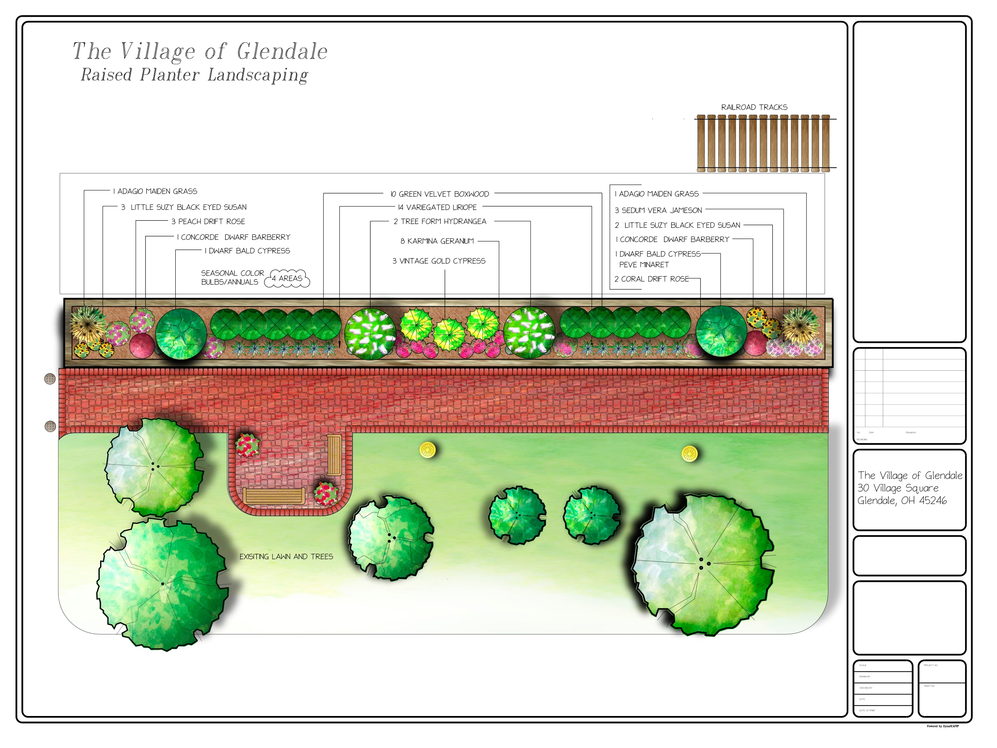
Pedestrian Crossing: 4

Slide 7
Pedestrian Crossing: 5

Slide 8
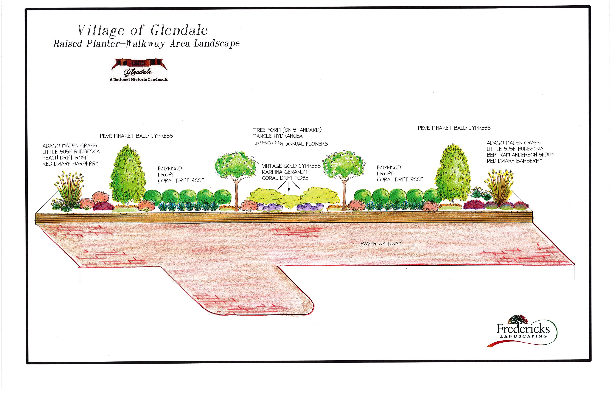
Pedestrian Crossing: 6

Slide 9
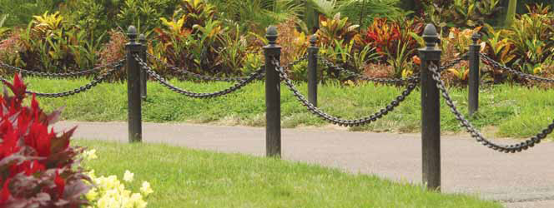
Pedestrian Crossing: 7

Slide 10
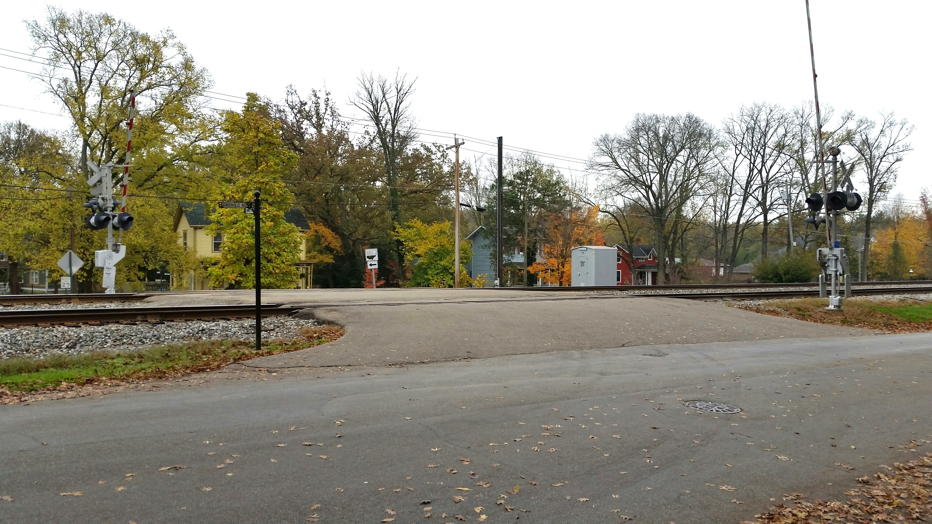
Current
Albion
Crossing
Proposed

Slide 11
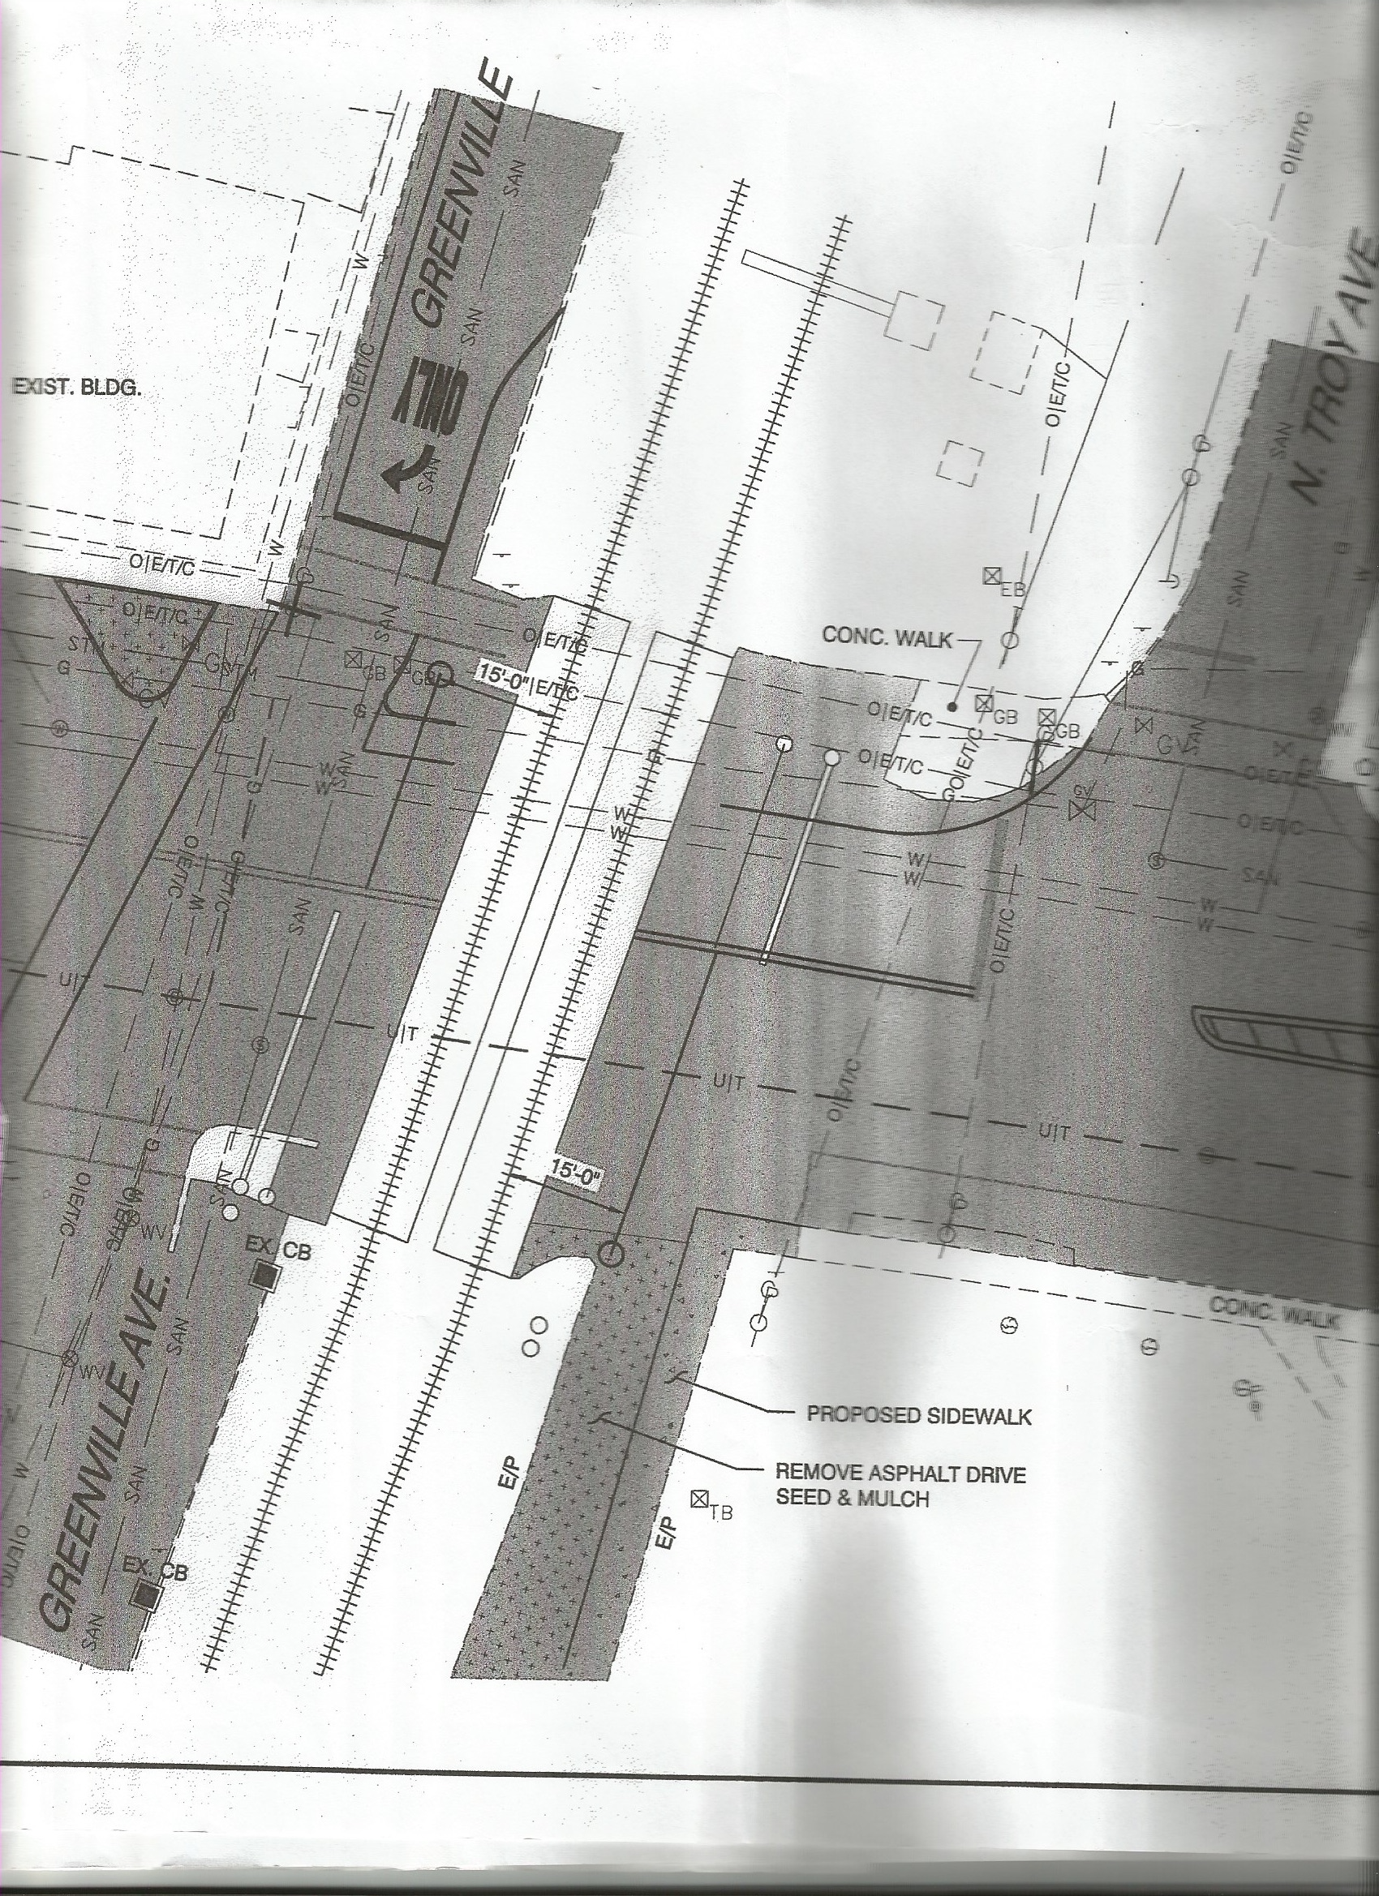
N. Greenville

Slide 12
